Slide 1
Bias & Fairness
in ML
https://github.com/semmi88/teaching

Slide 2
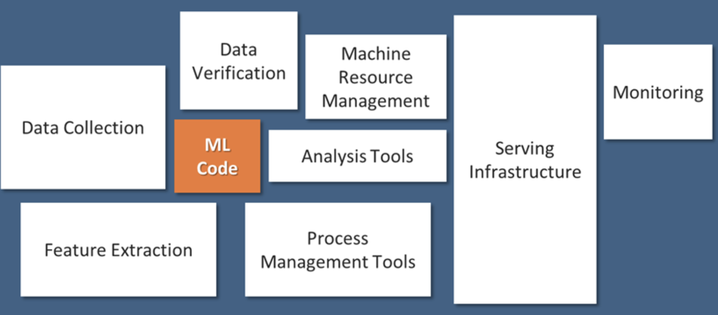
ML systems are hard
- lack of understanding of how exactly the neural nets work (black box,million params)
- dependencies on the training data, evaluation data, hidden biases
- real life context is hard, human users
- support systems (infrastructure, machines, monitoring) - MLOps

Slide 3
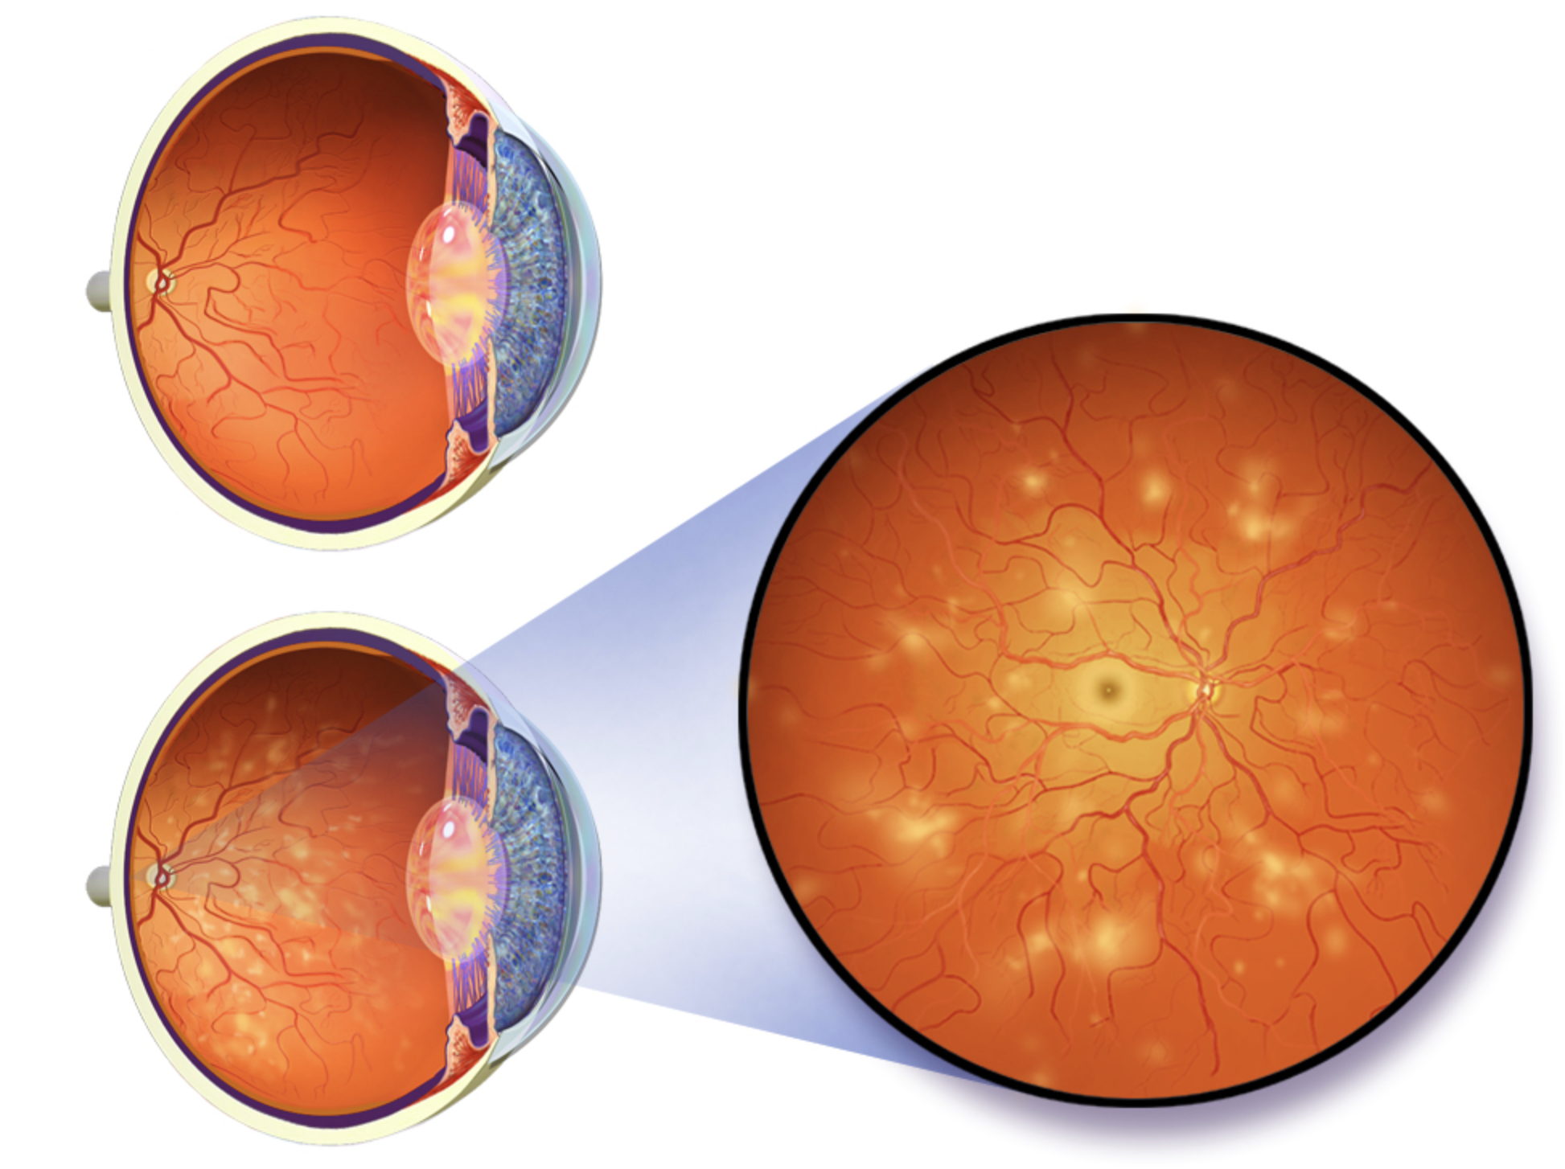
Case Study: Google Health 2020
- diabetic retinopathy - eye disease
- 80% diabetic people could develop it - is the result of damage to the small blood vessels and neurons of the retina.
- one of the leading causes of blindness
- it has no early warning signs, but if detected in time, blocked or leaking blood vessels, high chance that it can be treated (90%)

Slide 4
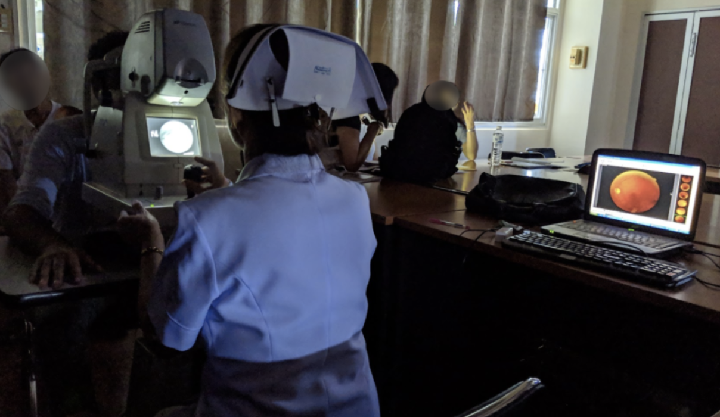
10 weeks vs 10 minutes
- Thailand Health Ministry: annual screening of 60% of diabetic people for diabetic retinopathy
- roughly 4.5 million patients, only 200 eye specialists, spread around the country
- nurses take photos of patients’ eyes, send them off to specialist (can take up to 10 weeks)
- Google Health developed an ML system with 90% accuracy in identify signs of diabetic retinopathy (“human specialist level”) — result in less than 10 minutes
Notes:
60+ patients/day the whole year

Slide 5
Lab accuracy != Real life outcomes
Reality
- train-test discrepancy: low quality images, poor lighting, (1 of 5 rejected)
- rejected patients - unnecessary travel, missed work, anxiety, no car, lowers trust
- frustrated nurses, the algorithm rejected scans showing no signs of disease (unnecessary follow-up) - time wasted retaking/editing images
- patients/nurses expected instant results, but slow internet connection sometimes made them wait hours instead of minutes
Assumptions
- training data: high quality images
- better to reject, than give lower accuracy result
- not relying on nurse judgement
- high bandwidth internet connection

Slide 6
Lessons learned
user-centered design process
understand how AI tools are going to work for people in a context
there is more to health care than algorithms
people’s needs, expectations, trust
- reality vs AI hype (COVID coughing, tongue swollen, ChatGPT)
- when it works well, huge benefit - unstoppable nurse 1000 patients scanned on her own
- patients didn’t care who read images (AI or human) - they cared more about their experience - waiting time, follow-up
- is it useful comparing AI to human? human doctors disagree all the time - AI tools need process to discuss uncertainties, rather than simply reject

Slide 7
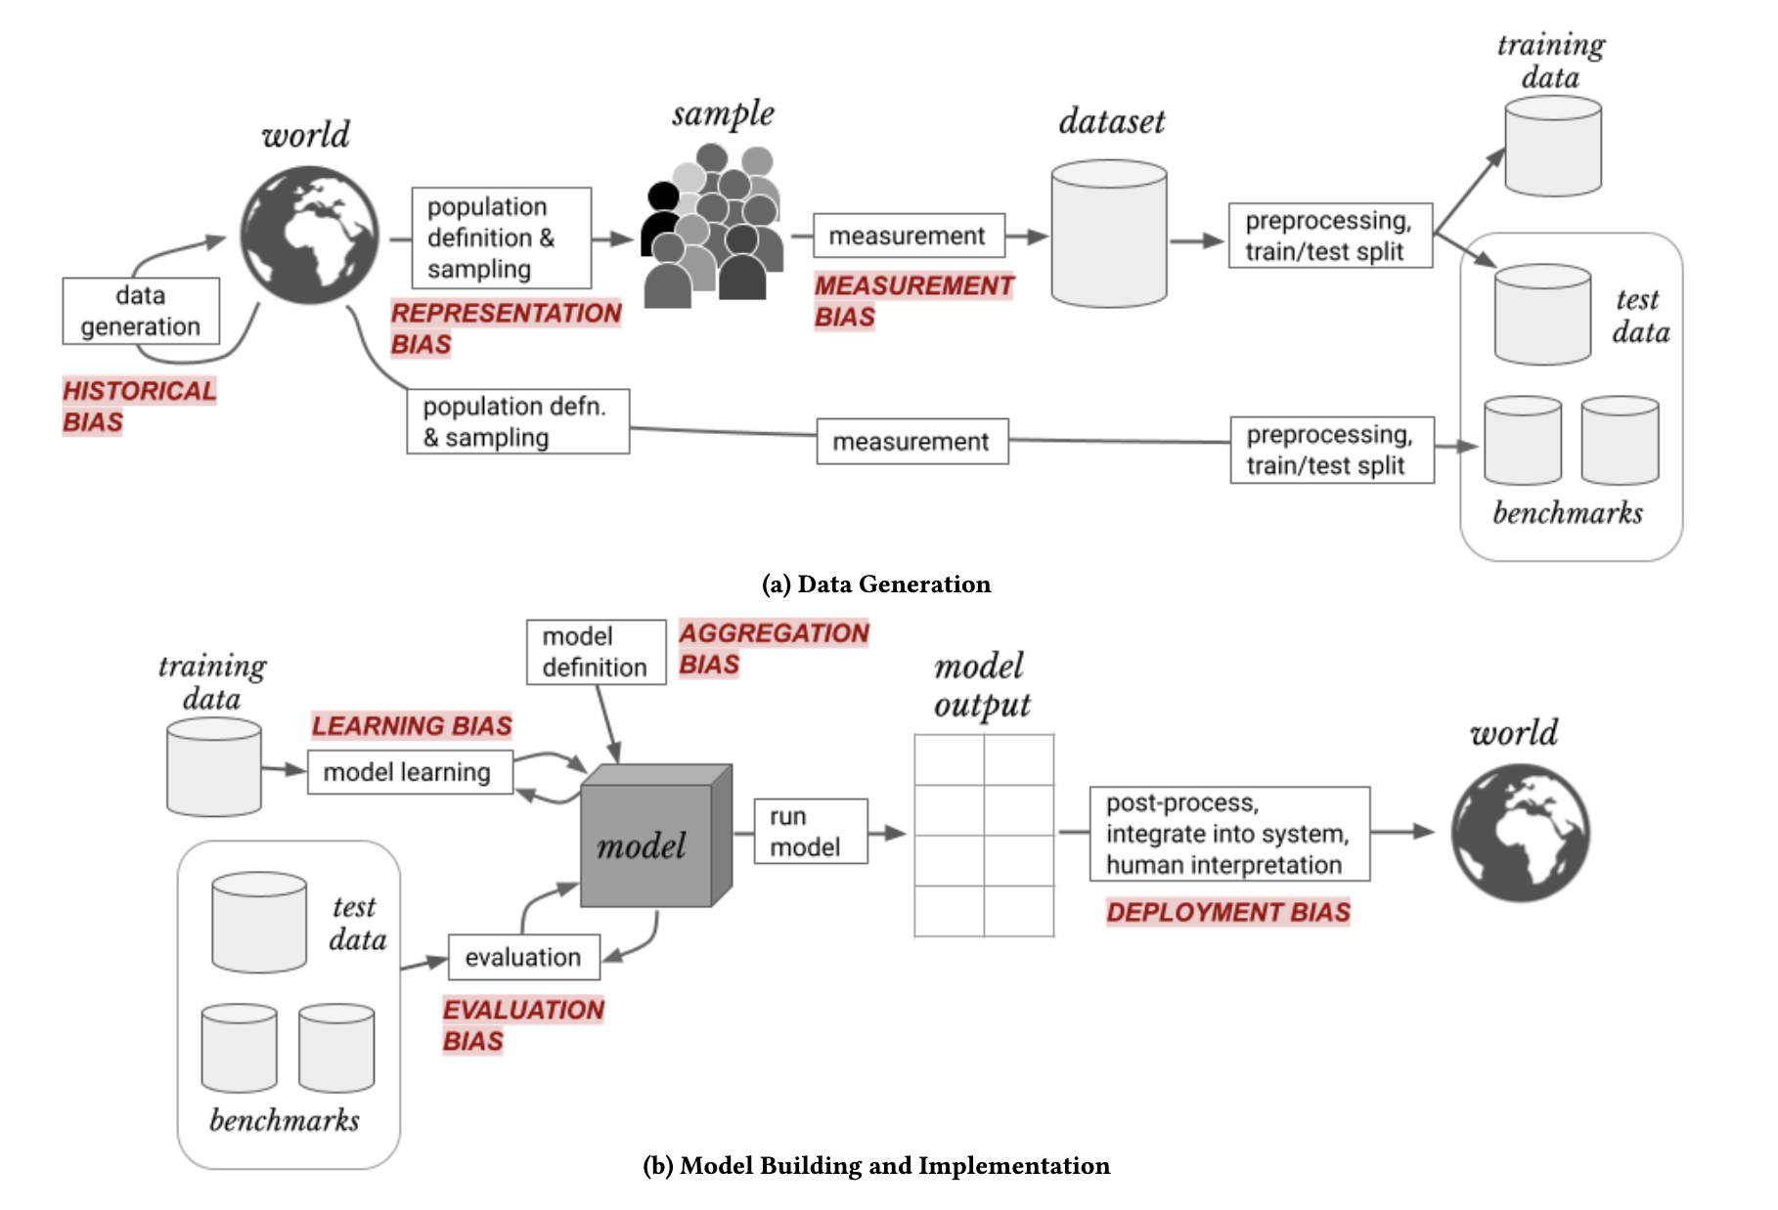
Bias - unintended consequences
- where does it come from?
- how to address it?
representation bias evaluation bias historical bias measurement bias aggregation bias
Notes:
A Framework for Understanding Sources of Harm throughout the Machine Learning Life Cycle

Slide 8
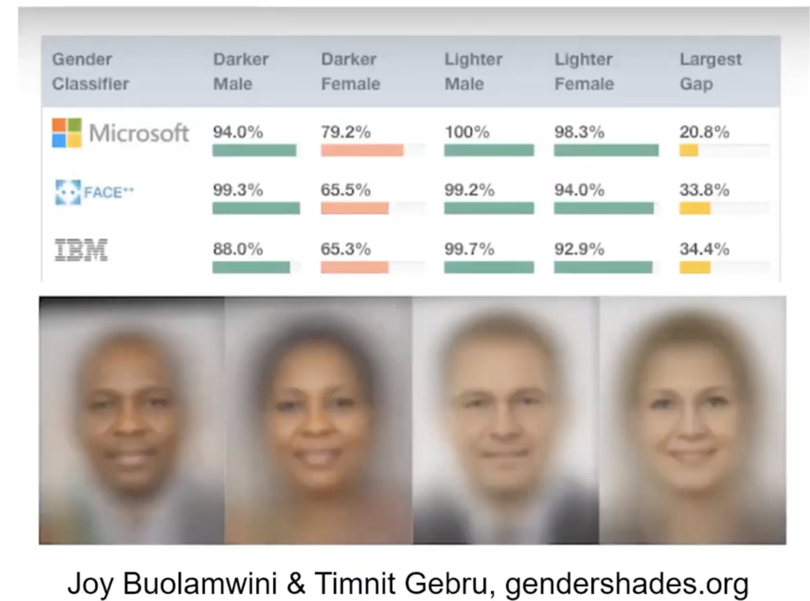
Representation bias
- flawed data sampling
- training data is not representative (mostly light skinned man, vs only 4% dark skinned women)
- real life data vastly different
- faceId, face recognition access gate

Slide 9
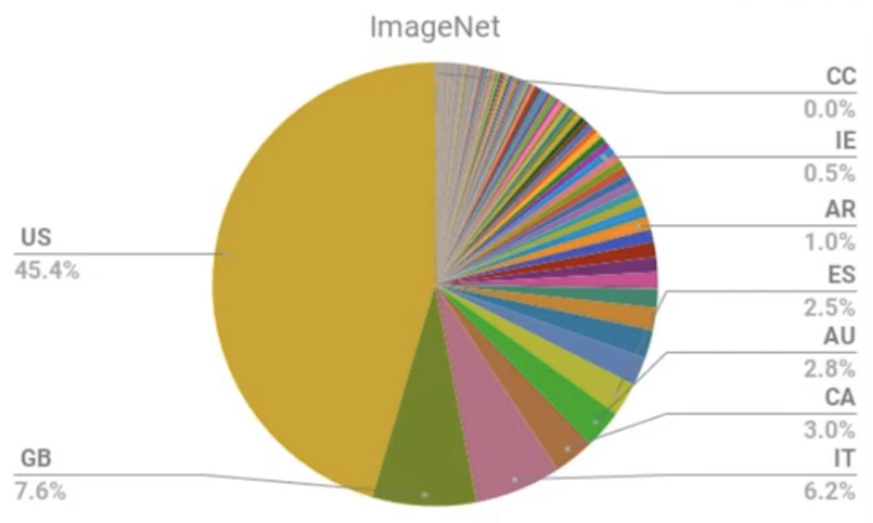
Representation bias
- training data is mostly images from the western world/culture - not representative
- real life data - algorithm errors - for wedding bride/groom from india/egypt is mislabelled by algorithms

Slide 10
Evaluation bias
- same benchmark dataset used by many companies to develop algorithms
- same biases replicated at scale

Slide 11
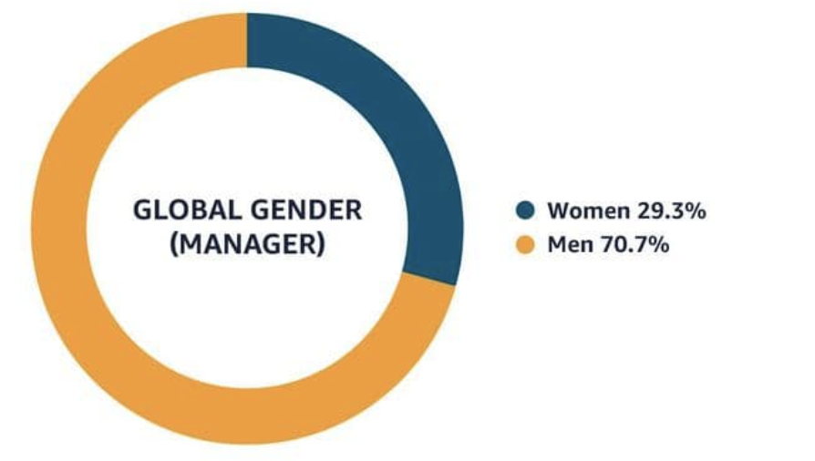
Historical bias
- fundamental issue with the first step - when we are generating data
- can exist even with perfect sampling and feature selection
- Amazon’s HR dream tool 2015: given 100 résumés, spit out top five
- trained on resumes submitted in the previous 10 year, mostly from men, a reflected of male dominance across the tech industry

Slide 12
Measurement bias
measuring the wrong thing
try to measure crime, but you can only measure re-arrest statistics
try to measure stroke predictive symptoms, but ended up measuring health insurance usage (EHR)

Slide 13
Aggregation bias
Performance difference between group
Choosing how to set thresholds affects outcomes

Slide 14
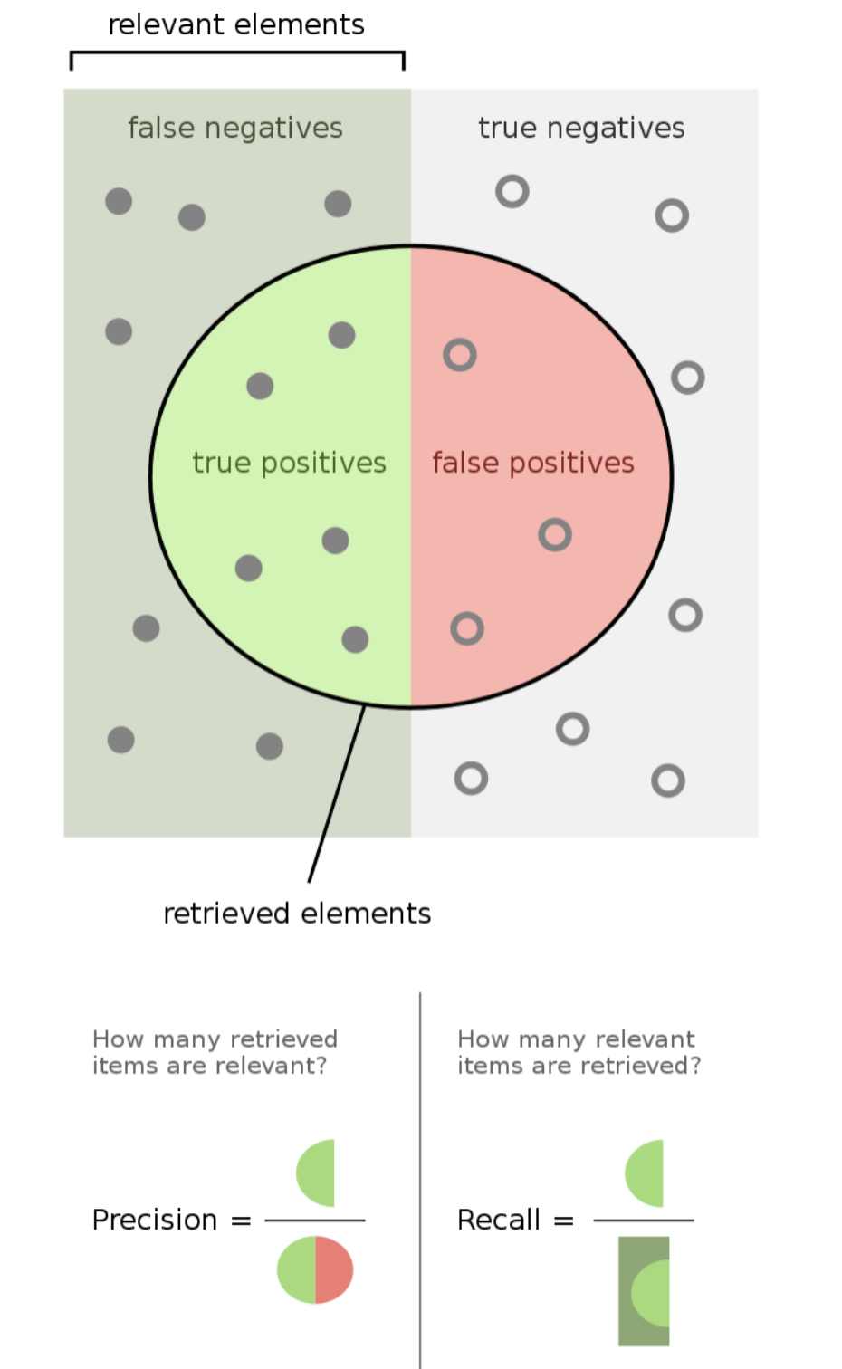
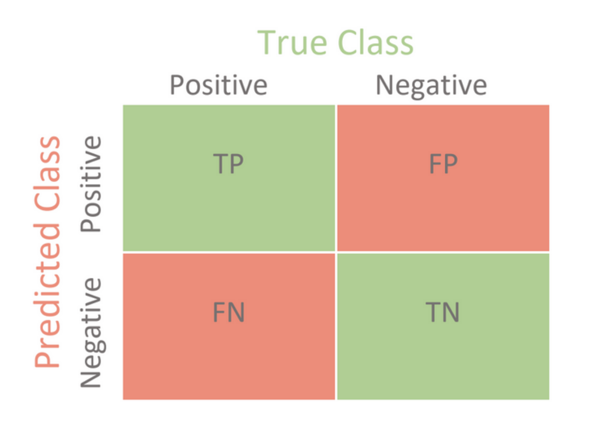
Classification thresholds

Slide 15
Spam

Slide 16
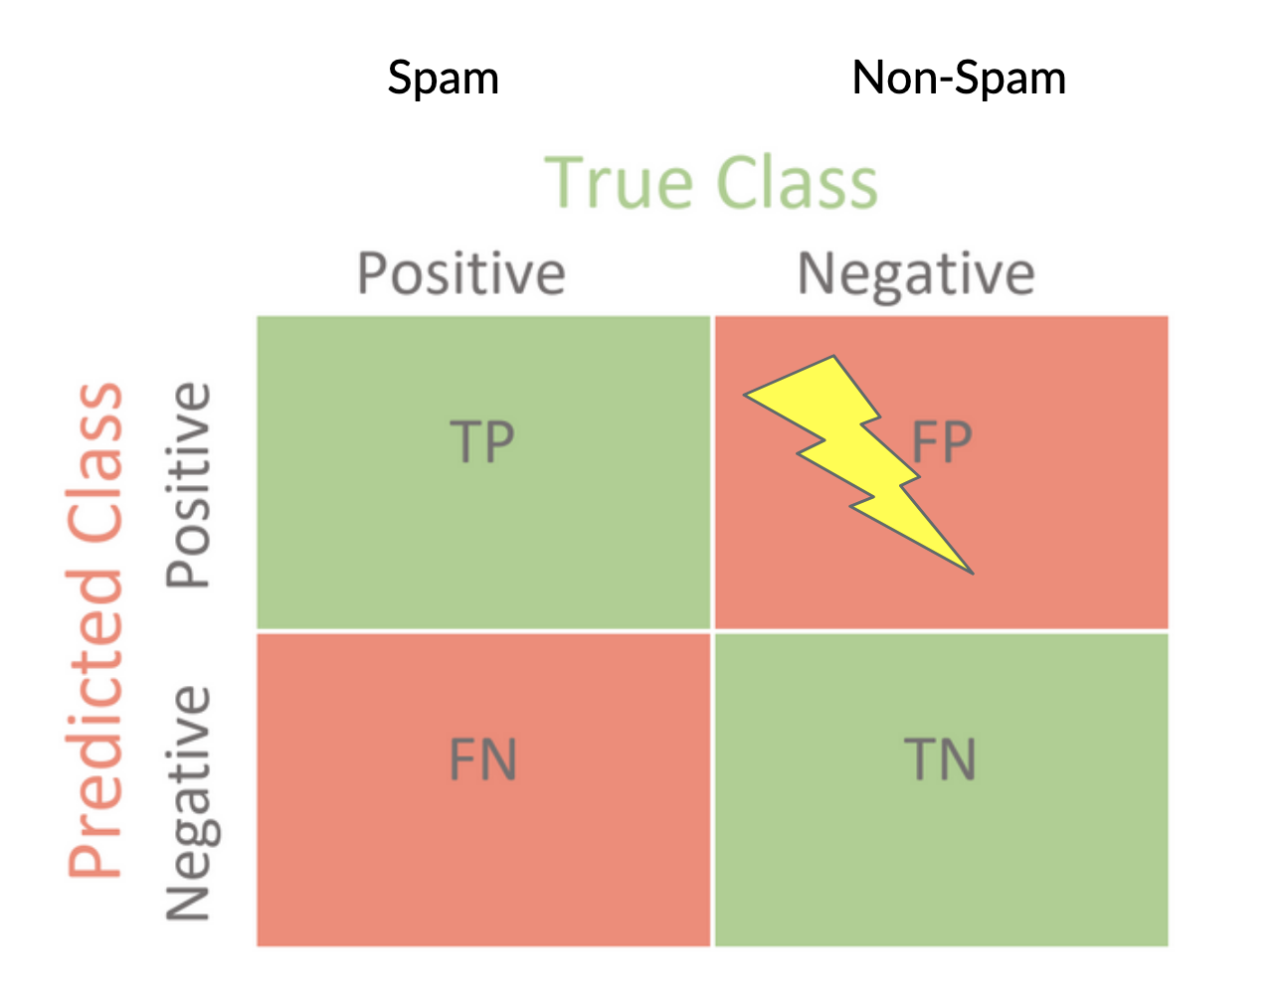
Spam

Slide 17
Pregnancy

Slide 18
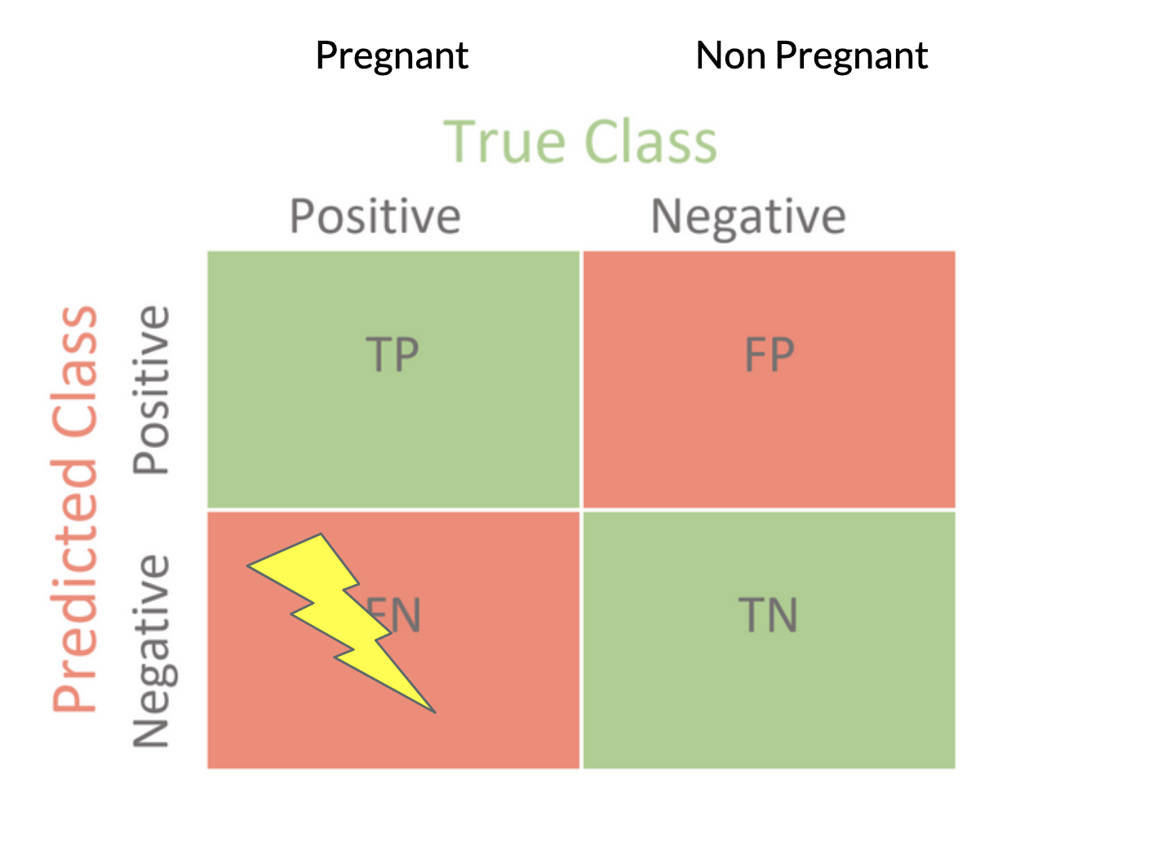
Pregnancy

Slide 19

So what?
Humans are biased as well, so why is there so much concern about algorithmic bias?
Example:
Traditional car manufacturer company, looking for a new team manager role

Slide 20
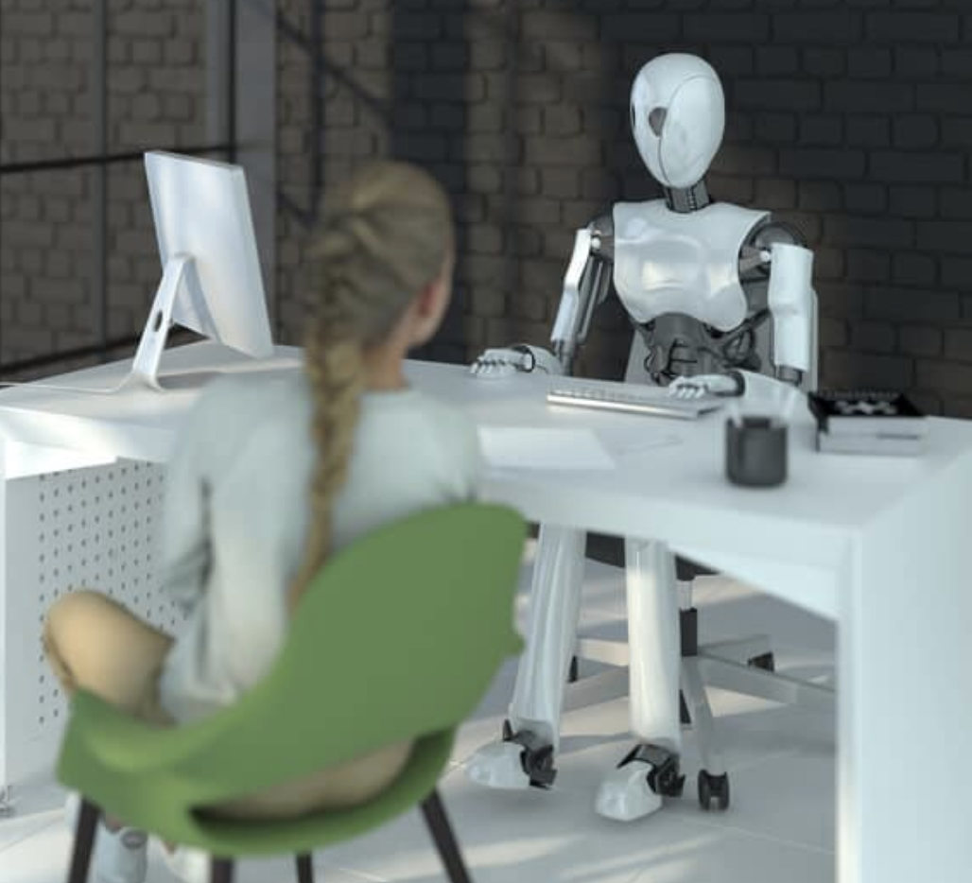
Scale
- 1 biased HR human will affect the changes of a few people
- hiring ML tool - deployed at scale - has impact at scale - can affect everyone applying to all companies using it
ML can amplifies bias

Slide 21
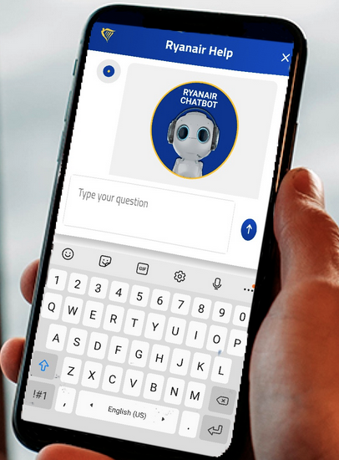
Appeals
- human decision maker can find workaround and handle issues case-by-case given the circumstances
- for automate decision ML tools - if a mistake happens, usually no appeal process - cost cutting measure
- case-by-case unique workarounds don't scale

Slide 22
“The privileged are processed by people,
the poor are processed by algorithms”
(Cathy O’Neil)

Slide 23
Fairness ~ Trolley problem

Slide 24
Fairness ~ Trolley problem
Unpleasant reality: there are multiple desirable things that we want, and we can't have all of it
There is no "one true definition" of fairness, there are only tradeoffs
different between group fairness
similar individuals should be treated similarly - group vs individual fairness
fairness vs utility

Slide 25

Fairness - Teaching context
groups of student with different skills, talents and abilities
- raise the ceiling
- min SLA bar
- raise the floor

Slide 26
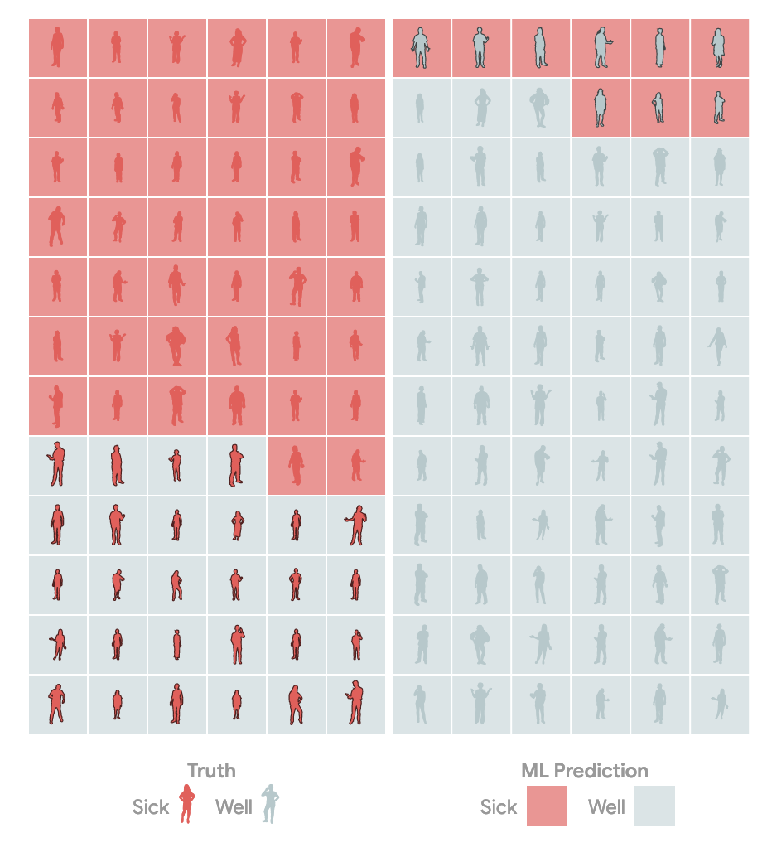
Fairness - it’s harder than you think
- no universal definition
- different ways to measure accuracy
- first problem: quantify/prioritize False Positives vs False Negative
- frequency of screening, cost of follow-up test, treatment/drog supply, risk of delayed detection
Notes:
https://pair.withgoogle.com/explorables/measuring-fairness/

Slide 27
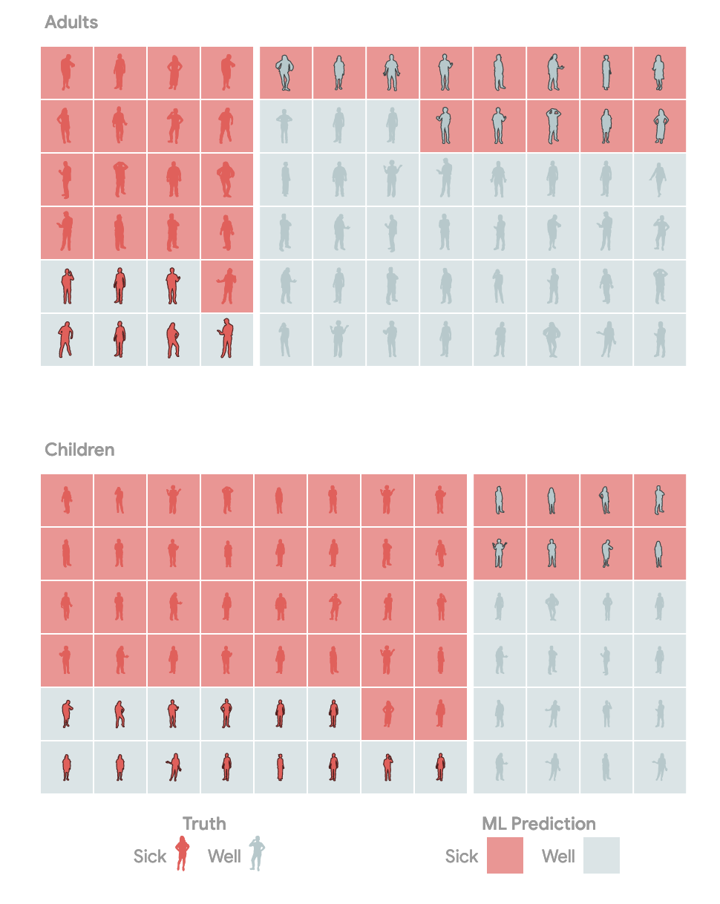
Fairness - across groups
- differences/disparity between groups - different prevalence/base rate
- second problem: quantify/prioritize accuracy differences between groups

Slide 28
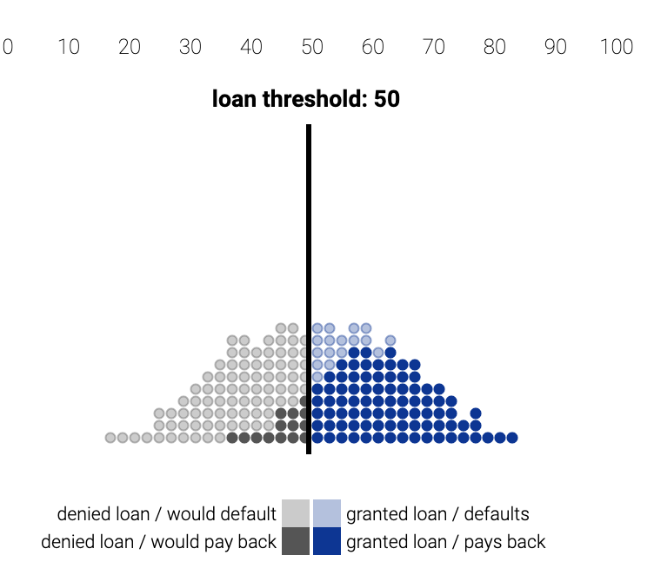
Selecting a fair threshold
- given a scoring system, is it possible to find a “fair” threshold?
- loan application
- credit score - number of factors, income, payment history, promptness in paying debts
- decide who gets a loan and who doesn’t
Notes:
https://research.google.com/bigpicture/attacking-discrimination-in-ml/

Slide 29
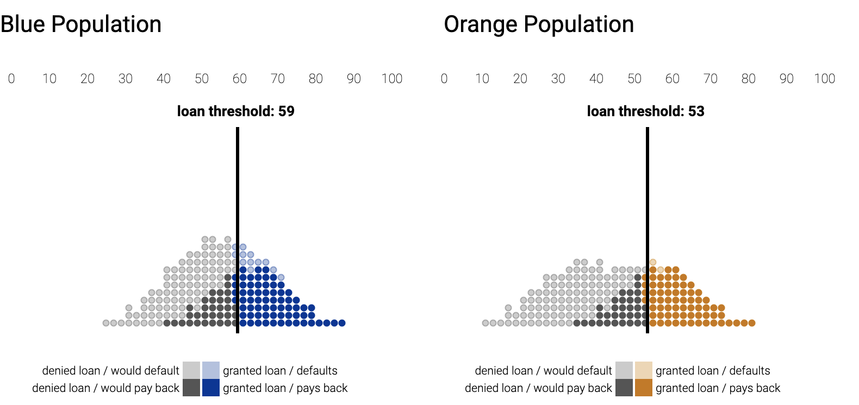
Possible strategies
Maximize Profit - different standards between groups
Group Unaware - same threshold applied - different percentages get loan
Demographic Parity - same percentage of loans given (whole group focus) - difference in loans paid back - fewer qualified people given loans in one group
Equal opportunity - same percentage of qualified people given loans - qualified sub-groups in focus

Slide 30
Fairness - Conclusions
- it is harder than you think
- it may not be possible to satisfy every definition of fairness
- focus on the notions of fairness that make sense for your use case/context of your model
- rely on domain experts, use a multidisciplinary approach

Slide 31
Allocation harm vs Representational harm
criminal justice, hiring, loan
withhold opportunities (economic)
immediate effect
re-enforces stereotypes
social harms
long-term effect

Slide 32
Grandma search

Slide 33
Grandma search
- how the imbalance in the ml system/search compares to real world imbalance
- does it mirror or does it exaggerates/amplifies bias
- is amplification bad?

Slide 34
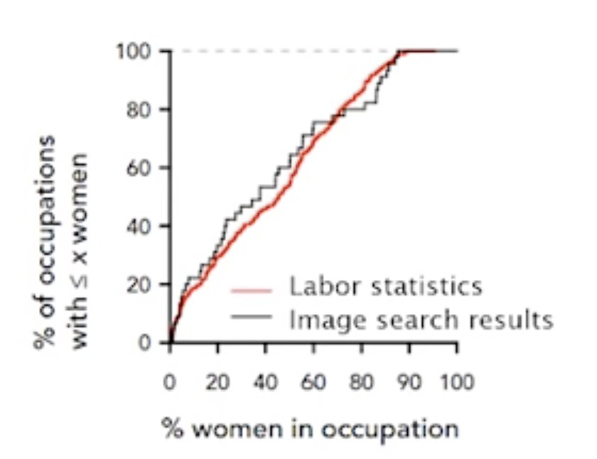
CEO search
- how the imbalance in the ml system/ search compares to real world imbalance
- does it mirror or does it exaggerates/ amplifies bias
- is mirroring good?

Slide 35
References
- Google Health’s medical AI fails
- Fast.ai course - Bias and Fairness
- Article - Understanding source of bias
- PAIR - Measuring Fairness
- Google Research - Attacking discrimination

